Slide 1
SUPPLY CHAIN ANALYSIS

Slide 2
INTRODUCTION
Supply chain analytics plays a crucial role in optimizing the movement of products and services from suppliers to customers, especially in industries like fashion and beauty, where consumer preferences and market dynamics can change rapidly. This project focuses on the supply chain of a startup in the Makeup products sector, utilizing data-driven insights to enhance operational efficiency and improve decision-making processes.
The dataset comprises various features related to the supply chain of makeup products, including product type, SKU, pricing, customer demographics, stock levels, lead times, shipping details, manufacturing costs, and quality inspection results. By analyzing this dataset, we aim to identify trends, inefficiencies, and opportunities for improvement within the supply chain

Slide 3
OBJECTIVE
Data Analysis and Interpretation: Collect, analyze, and interpret data related to the movement of makeup products, focusing on various factors such as sales performance, inventory levels, and customer demographics.
Identify Key Performance Indicators (KPIs): Determine and establish relevant KPIs to measure the effectiveness of the supply chain, including metrics related to sales, revenue generation, stock availability, shipping times, and defect rates.
Optimize Supply Chain Operations: Use analytics to identify bottlenecks and inefficiencies in the supply chain, providing actionable insights to optimize processes such as order fulfillment, inventory management, and supplier performance.
Customer Insights and Demographics: Analyze customer demographics to understand purchasing patterns and preferences, which can guide marketing strategies and product development.
Cost Reduction Strategies: Investigate shipping costs, manufacturing expenses, and inspection results to recommend strategies for reducing overall supply chain costs while maintaining product quality.
Enhance Decision-Making: Utilize the insights gained from the data analysis to support strategic decision-making within the organization, leading to improved operational efficiency and customer satisfaction.

Slide 4
MAIN KPIs
Sales Performance
Inventory Turnover Ratio
Order Fulfillment Rate
Lead Time
Defect Rate
Shipping Cost per Order
Stock Availability
Customer Satisfaction Score
Cost of Goods Sold (COGS)
Production Volume Efficiency

Slide 5
TABLEAU
In this project, Tableau is employed as a powerful data visualization tool to analyze and present the supply chain data of the Makeup products startup. It enables the creation of interactive dashboards that visually represent key metrics and KPIs, making complex data more accessible and understandable for stakeholders.

Slide 6
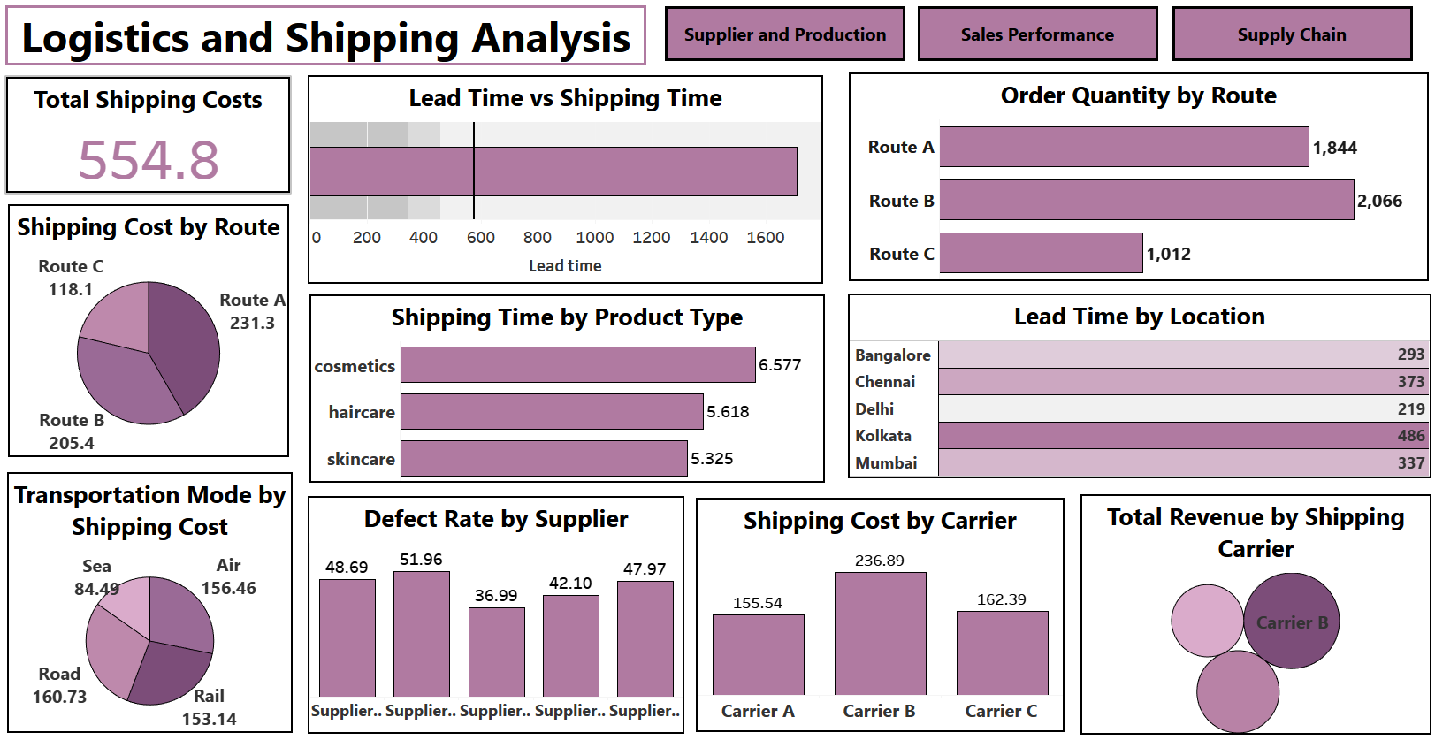

Slide 7
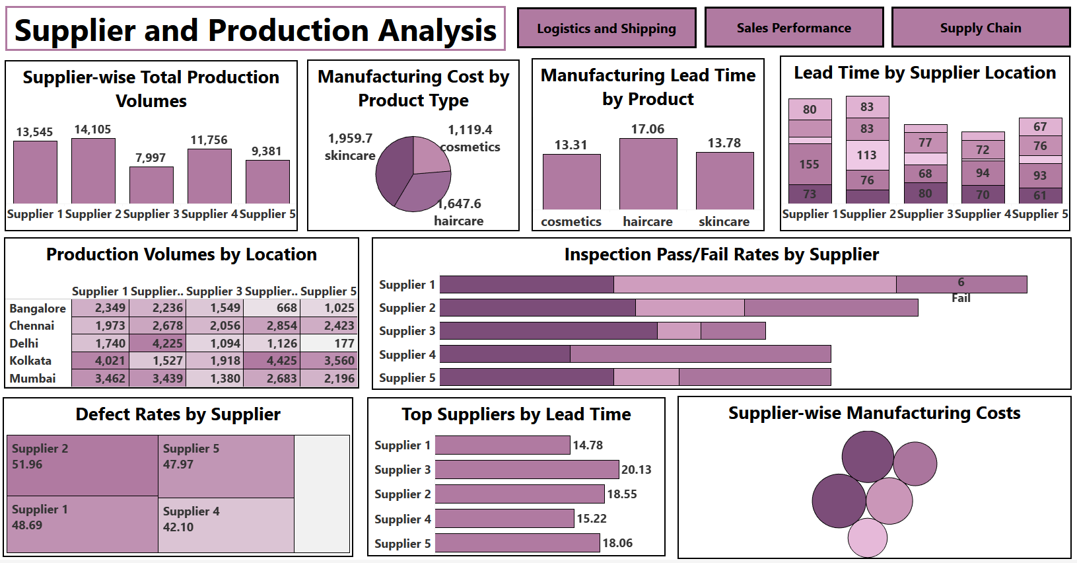

Slide 8
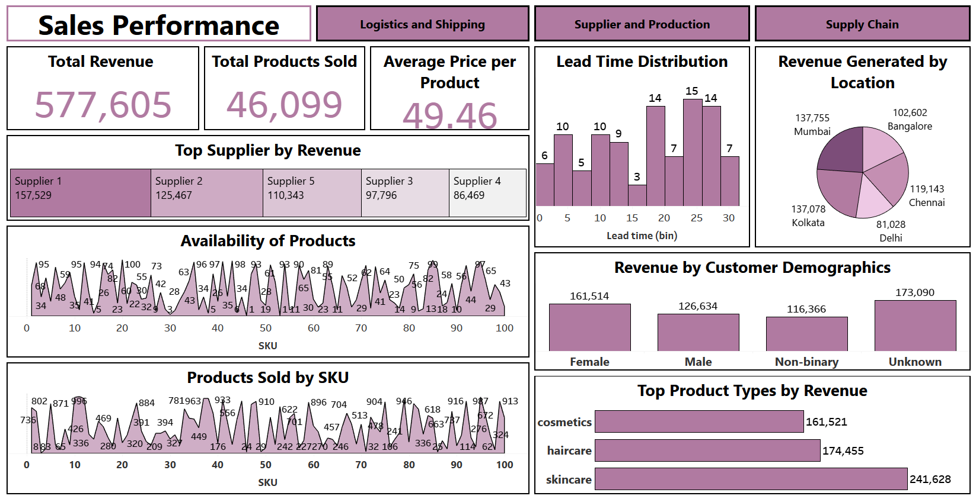

Slide 9
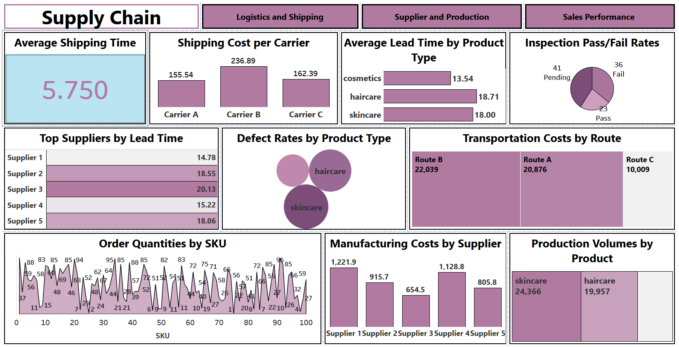

Slide 10
MY SQL
In this project, SQL is used to efficiently manage and analyze the supply chain data for the Makeup products startup. It enables data retrieval through queries that extract key metrics such as sales figures, inventory levels, and customer demographics.

Slide 11
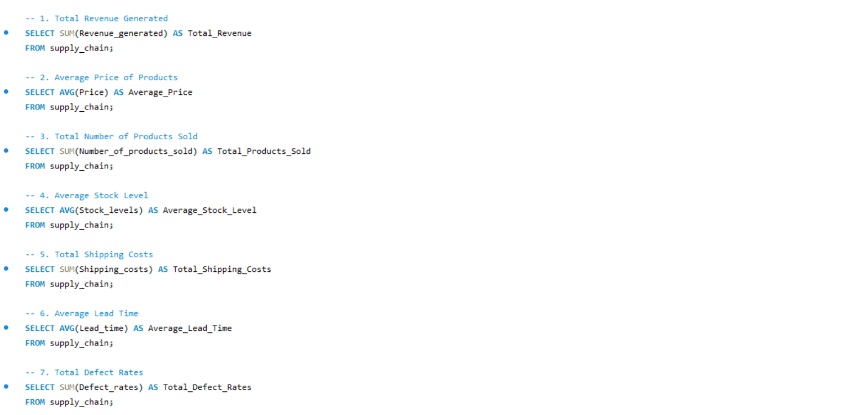

Slide 12
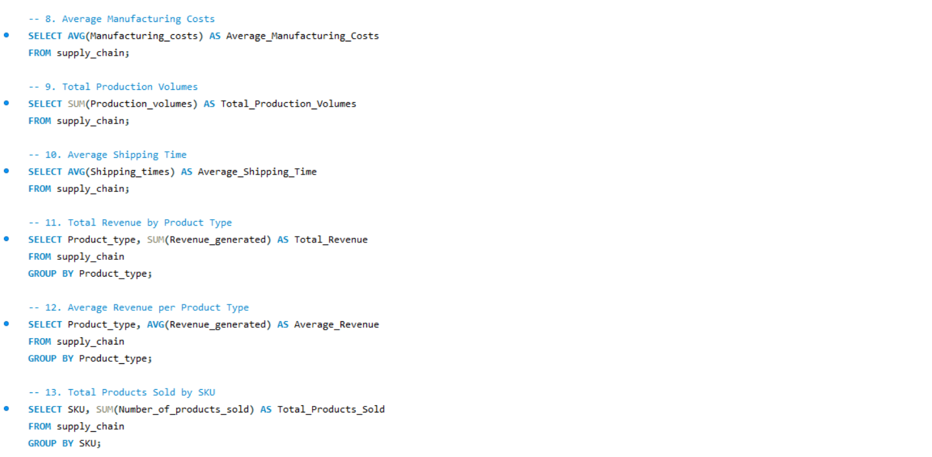

Slide 13
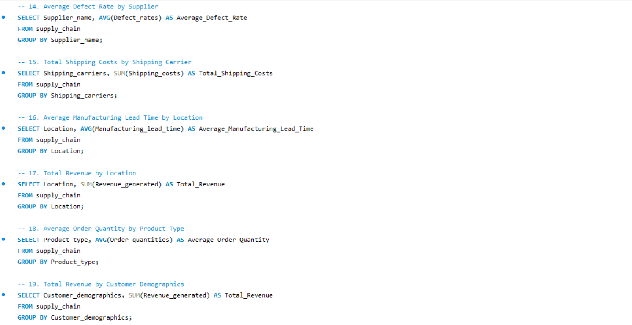

Slide 14
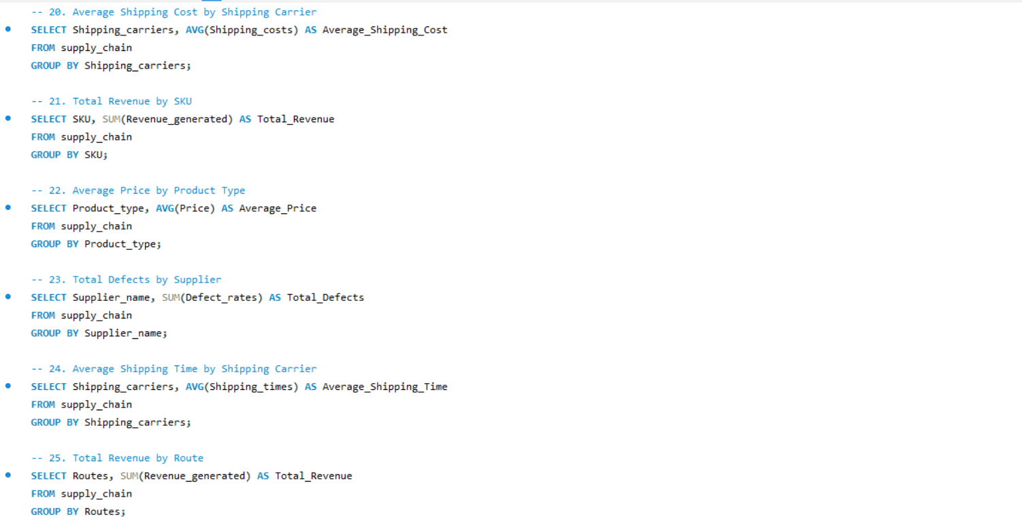

Slide 15
POWER BI
In this project, Power BI is utilized to create interactive and visually compelling dashboards that present the supply chain data of the Makeup products startup. Power BI enables users to transform raw data into insightful visualizations, making it easier to understand complex information at a glance.

Slide 16
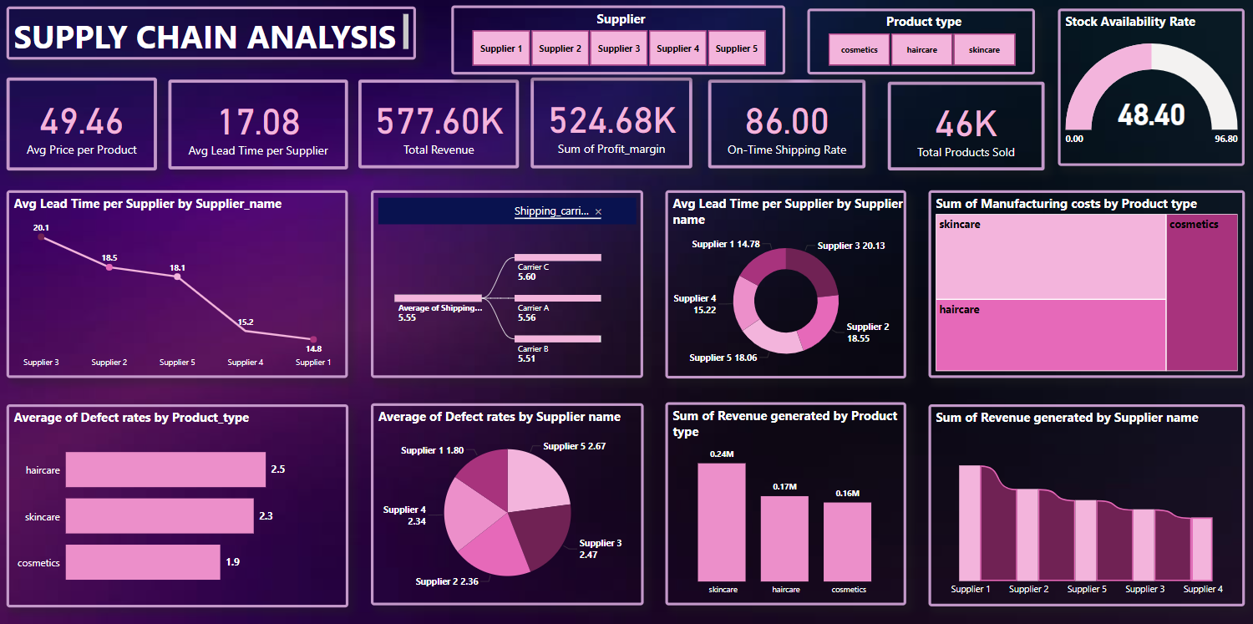

Slide 17
CONCLUSION
In conclusion, effective supply chain analytics is vital for the success of a Makeup products startup, enabling data-driven decision-making that enhances operational efficiency and customer satisfaction. By analyzing key performance indicators (KPIs) such as sales performance, inventory turnover, lead times, and defect rates, the startup can gain valuable insights into its supply chain operations.
These insights help identify areas for improvement, optimize processes, and reduce costs while maintaining product quality. Additionally, understanding customer demographics and satisfaction can inform marketing strategies and product development, ensuring alignment with market demands.
Overall, leveraging analytics in the supply chain not only drives profitability but also positions the startup for sustainable growth in a competitive beauty industry landscape. By continuously monitoring and refining its supply chain practices, the startup can adapt to changing consumer preferences and operational challenges, ultimately enhancing its market presence and customer loyalty.

Slide 18


VISIT FOR DETAILED PROJECT
Click on linkedin logo to visit my Profile
Click on Github logo to visit the portfolio of the project

